Slide 1
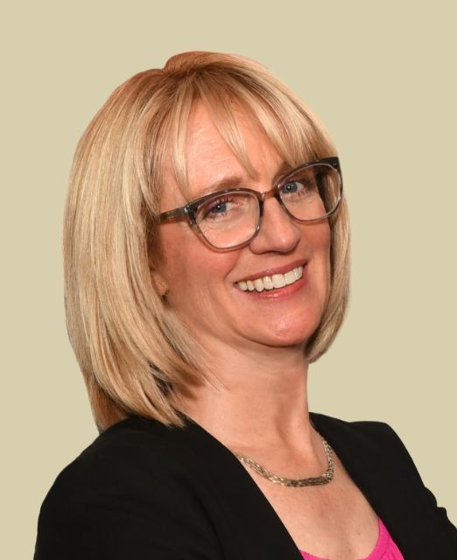
WHAT’S NEXT:
The AI Hype is Real
Lliam Holmes
Jennifer Holmes
KEYNOTE
EMCEE
Notes:
WELCOME! All Friends of MIS
I’m Jennifer Holmes, President here at MIS and we are glad you joined us today.
We created this program – Tech Exchange to equip and empower business leaders with insights and perspectives to help them make good business decisions.
Since AI is literally a new frontier – we dedicated this year’s program to starting a conversation.

Slide 2
THE NEW KID ON THE BLOCK
Artificial Intelligence (AI) is here to stay.
Today we’ll answer three foundational questions:
What is AI?
What’s the impact on your business?
How do you stay ahead of the game?
AI is Here
Notes:
When I say AI – it stirs a lot of emotions……excitement, curiosity, anxiety….
Let’s see who the room is feeling today?
Take a quick poll – who is excited , curious, overwhelmed, skeptical, fearful?
All this AI talk, tools and controversy can be exciting and overwhelming.
As business leaders we know to remain relevant - we must be part of the conversation;
There is a lot to unpack with AI and its evolving fast.
Today’s program was designed to launch an ongoing conversation to help us find the opportunities
Have awareness of the risks and avoid the pitfalls.
I invite you to open your mind to possibilities and use today as time to explore ideas and ask questions
Write questions as you go…
Because where idea disruption occurs – innovation happens.

Slide 3
KEEPING YOU AHEAD OF THE CURVE
UTM
IMAGE-BASED
BACKUPS
PRIVATE CLOUD
VOIP
CYBER-DEFENSE
EDUCATION
2007
2012
2020
Notes:
Here at MIS – we have a track record of being our clients “sherpa” in the tech space.
A guide on the side.
You may recall back in 2010 when cloud was the new kid on the block and not fully developed – we were having conversations and advising our clients about it.
Having conversations on emerging tech is key to staying relevant for all of our organizations.
Helps you position your business for success

Slide 4
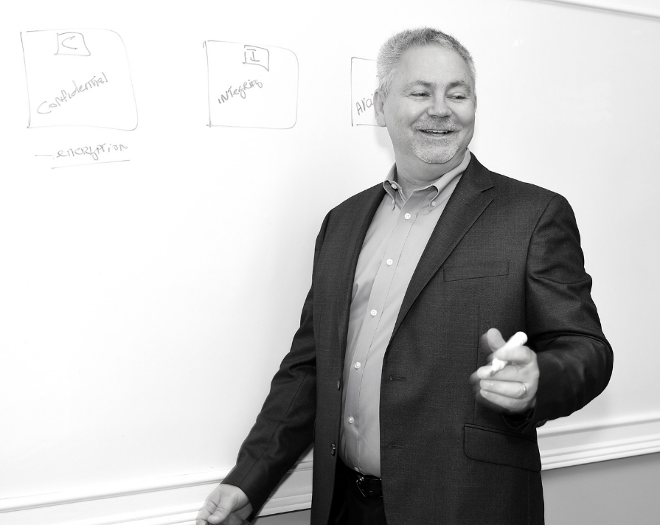
Lliam Holmes
Cybersecurity Expert
Premier Integrator
Technology Visionary
Notes:
I’d like to introduce our key note speaker today. Lliam Holmes
Many of you know him as a Certified Ethical Hacker and our CEO.
He has more security certs than alphabet soup and decades of experience.
Over history of MIS, our clients and friends have relied on him as their Technology Visionary.
Since AI is such a big topic that will transform our work, how we interact with customers and do business. – we wanted to lay the foundation and make sure you are part of the conversation.
Our customers have told us that one of the things MIS Solutions does is to not just be part of the conversation, they MAKE MY BUSINESS BETTER.
And so while in years past, we've talked a lot about security... This year, we're actually pivoting, and we want to talk about what’s NEXT and some ways you can leverage what’s NEXT to make your business better.
Please put your hands together and help me welcome, Lliam Holmes.

Slide 5
Notes:
Dramatic and faux whispering tone:
I want you to just pause for a moment.. clear your mind.. bookmark the year 2023 as the year AI changed the world..
Weather you know it or not - we are all witnessing the next technical revolution; it is so powerful that it will change evolution of humanity from this point forward.
If you could go back in your mind and remember the first time you heard about the internet. Imagine if you knew then how fundamental this technology would become in the lives of every business, in fact, every single person on the planet. What would you have done differently? How would your life have changed? Where would your business be today?
What if I were to tell you that we are all watching the internet be re-born and that your business will be significantly different in the next 5 to 10 years?
Today we are witnessing the true and unmistakable implementation of Artificial Intelligence into the global business landscape.
I am not here to tell you that we are all going to be replaced by machines but I am here to tell you that every company is going to have to adapt and learn new skills to remain relevant.

Slide 6
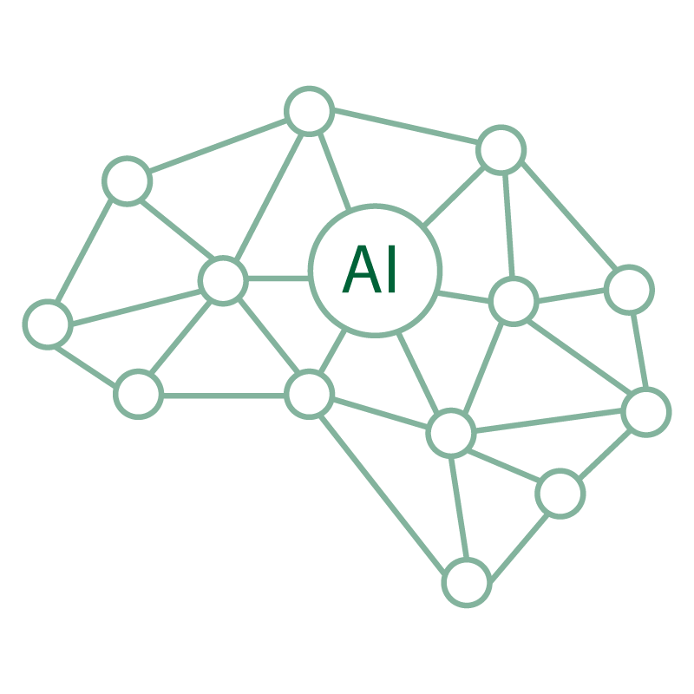
Definition of AI
A branch of computer science dealing with the simulation of intelligent behavior in computers.
AI is defined as the capability of a machine to imitate intelligent human behavior.
Notes:
Before we can talk about AI, we need to understand what it is. Because –
what you think it is,
what you neighbor thinks it is
what I think it is
may not be the same thing.
Here’s how I define it:
Artificial Intelligence (AI) is the simulation of human intelligence in machines that are programmed to think, learn, and make decisions in a way that mimics a human being.

Slide 7
Notes:
It is important to know that AI isn’t something that just made its way into main street in 2023 – this has been a long time coming – nearly 73 years in the making.
Some of the more significant milestones include:
1950 – Alan Turing published a book “Computer Machinery and Intelligence”
1964 – the first chatbot was capable of holding a conversation with a human
1997 – Deep Blue defeats chess grandmaster Gary Kasparov in a game of chess.
2011 – Apple introduces Siri virtual assistant
2011 – IBM Watson wins 1st place on Jeopardy
2014 – Amazon launches Alexa
2020 – GPT-3 is introduced
2022 – ChatGPT is introduced to the public for testing
Of note is the incredible amount of advancement in this space since 2011.
In 2023 alone – almost 7000 new AI enabled tools have been created.

Slide 8
NOTABLE AI STATISTICS
Global AI market is estimated to be $136 billion
Global AI market will increase 13x over the next 7 years
The US AI market is forecast to reach $299.64 billion by 2026
Netflix makes $1 billion annually from automated personalized recommendations.
By 2025 as many as 97 million people will work in the AI space (US Population is currently 334 million)
83% of companies claim that AI is a top priority in their business.
Source: https://explodingtopics.com/blog/ai-statistics
Notes:
I’ll highlight a few of the notable statistics around AI:
83% of companies claim that AI is a top priority
Netflix is using AI to generate more than $1B a year from personalized recommendations
AI market will increase 13x in the next 7 years (what other business do you know that will do that?)

Slide 9
AI Methods
Speech Recognition
Deep Learning
Classification
Reasoning
Supervised Learning
Image Recognition
Unsupervised Learning
Notes:
AI has methods or modalities that it uses to collect and interact with us
Here are seven of the most common modalities in use today.
This list is expected to EXPLODE in the coming years.

Slide 10
CHALLENGES OF AI
AI algorithms are complex.
AI systems are also prone to bias, as they are often trained on biased data sets.
AI technology is also expensive.
Companies must be able to interpret and act on the data generated by AI systems.
Require significant training data to produce accurate results.
Security and privacy - AI systems can be vulnerable to malicious attacks.
Difficult to implement.
Notes:
AI is not without its risks and challenges:
Complex / prone to misinformation
Biased - I will do a deep dive at a later event.
Risk of exposing company data - client lists, financials, compensation plans, IP, etc
Vulnerable to attack / malicious misuse.

Slide 11
SINGULARITY: INTELLIGENCE VS. WISDOM
Notes:
What can we expect from AI enabled systems today and tomorrow?
Today we can expect intelligence.
– structural awareness / knowing what to do
Tomorrow we can expect Wisdom.
– situational awareness / knowing when to apply intelligence
Singularity – humans = machines
Ray Kurzweil, head of Google’s AI predicts singularity will happen by 2045 – that is 22 years from now folks!
If you look back over the last 22 years a lot has happened and I don’t think we could have ever predicted where we would be today – keep your expectations “flexible”

Slide 12
Lots of Different Networks:
Biggest is called ChatGPT
Notes:
Today the biggest and most well known AI tool is called ChatGPT but it is worth knowing that there are many, many tools out there – they are not the only kid on the block.
Google – Bard | AWS - Lex | IBM – Watson | OpenAI - Chat GPT
There is a war of machines among all these tools
Each knowledge base is different,
Each is developing their own neural networks, tools, products and services.
For Example:
OpenAI just introduced their business plan - $42 a month
Microsoft just introduced AI tools for Microsoft office - $30 per user / a month
IBM Watson driven ChatBots - $140 a month
Does anyone remember the war between NetScape and Internet Explorer? This is like that.

Slide 13
TODAY’S FOCUS: ChatGPT
Notes:
For this presentation we are going to focus on ChatGPT as it is the most well-known.
Some things you might know about ChatGPT -
Over 100M subscribers in the first two months of existence.
Microsoft paid $13 billion for Open.AI back in April of this year.
Microsoft pouring in nearly $1 billion a MONTH into AI technologies

Slide 14
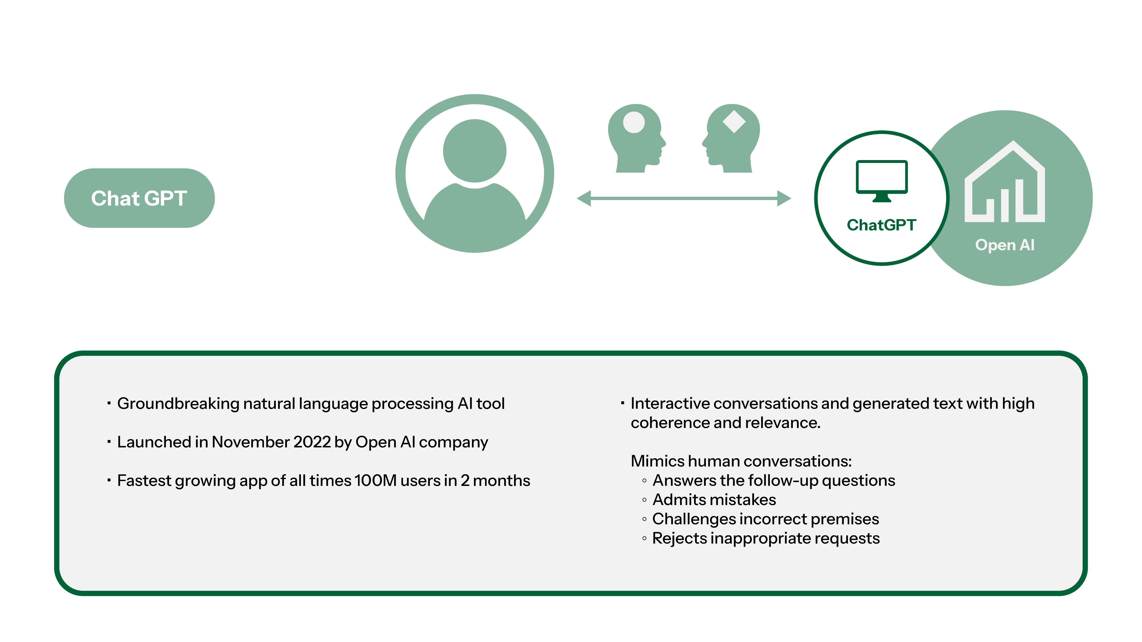
Definition of Chat GPT
Notes:
What is ChatGPT? it is a text based chatbot that can also access plugins to give it additional skills like creating videos and flowcharts.
The GPT is an acronym:
Generative – it generates text based output
Pre-trained – it is trained on large datasets from the internet
Books – Articles – Wikipedia
Scientific journals – Website scraping – Code repositories
Social Media – Blogs – Online forums
Transformer – Architecture used to understand and generate natural language.
In short: Text based questions = text based answers.
Two commonly overlooked items when using ChatGPT:
1) Participate in a conversation not just question / answer.
2) “Regenerate button” will create an alternative answer to your question

Slide 15
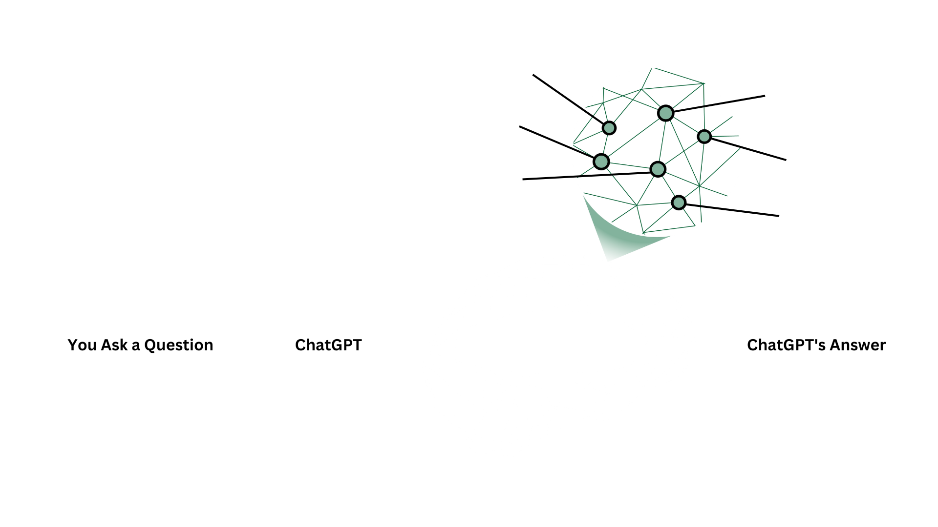
ChatGPT – HOW IT WORKS
Notes:
So how exactly does it work?
Let me walk you through this flowchart.

Slide 16
ChatGPT NEURAL NETWORK
Notes:
[on-stage prop]
The “Magic” or “Secret Sauce” = NEURAL NETWORK.
[Take the cloak off the prop]
WARNING: Knowing how the Neural Network works will show you why it is so controversial – we will get into all of this in my first “Road Show” – be prepared to have your mind blown; you are not going to want to miss it.

Slide 17
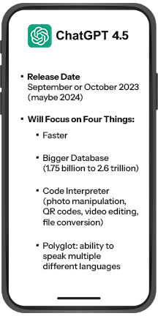
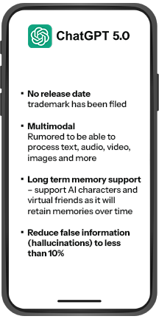
SHORT TERM HORIZON
Notes:
In the short term – next 12 months – where is this all going?
GPT 4.5
Almost here – release date – September / October 2023 – maybe 2024?
Will focus on 4 things:
Faster
Bigger database - (1.75 Billion to 2.6 Trillion)
Code Interpreter –
Photo manipulation
Create QR codes
Edit videos
File conversions
Polyglot – able to speak multiple different languages.
GPT 5.0 – CONTROVERSIAL RELEASE:
More than just text – More Modalities
Long term memory – virtual friends
Reduce misinformation to less than 10%.

Slide 18
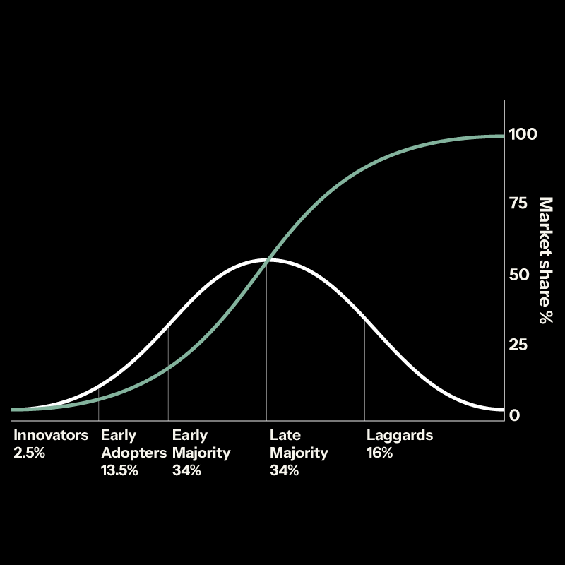
THE TIME IS NOW…
Notes:
NOW is the time to figure this stuff out.
There is a “grace period”
Start thinking about how AI applies to your business
Start thinking about how you will reposition.
Find a place to start / that “one thing”

Slide 19
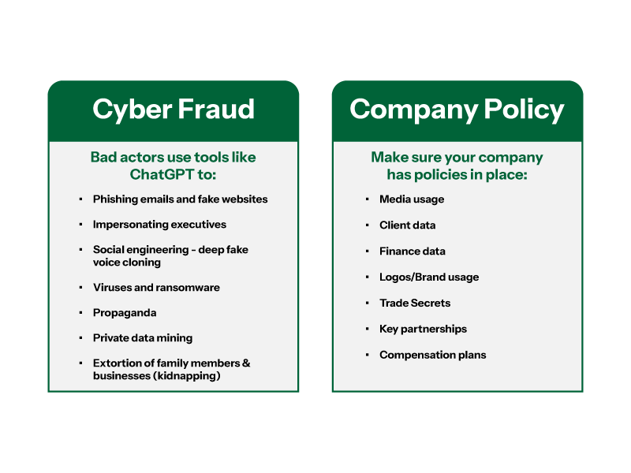
BUSINESS RISKS OF ChatGPT
Notes:
It should come as no surprise that bad actors are using these tools too.
Phishing emails
Fake websites
Impersonating executives
Social engineering – deep fake voice cloning
viruses / ransomware
Propaganda
Private data mining / disclosures
Extortion of businesses and family members. (kidnapping)
ANYTHING you have online or enter into ChatGPT is public information.
Protect your company:
Media usage policies
Client data usage policies
Finance data usage and disclosure policies
Intellectual Property (IP) policies.
Key partnerships in your business
Compensation plans

Slide 20
It is an AUTOMATOR
AUTOMATOR
A
Excels at organizing repetitive tasks very quickly.
THE ABC’s of AI
It is a BINARY DATA ANALYST
BINARY DATA
B
Very good at black and white; examining extreme contrasts in data points and contextual data.
Notes:
I've given you:
An overview of what AI is
What’s possible
What’s coming
What are some of the risks are
What policies you need to have in place to protect your business
Let’s talk about some of the positives!
ChatGPT does 4 things really well:
Automator – it excels at organizing & executing repetitive tasks
Administrative tasks like sending follow up emails
Creating job descriptions
Data Analyst – it is good at looking at datasets and finding outliers
Extracting and analyzing customer feedback from a database
Reports and dashboards

Slide 21
It is an efficient CURATOR
CURATOR
C
An excellent “Soup Starter” in that it provides an outline to be polished and vetted.
THE ABC’s of AI
DIGITAL ASST
D
It is a competent DIGITAL ASST
A sidekick to inform our day-to-day lives and automate routines.
Notes:
Curator – Great at making “soup starter” content because starting with a blank page is hard.
Creating marketing videos
Creating blog posts
Digital Assistant – AI is great at things like:
Scheduling appointments
Checking the status of an order
Alerting you when something happens
Creating itineraries and routes for business and personal trips
Teaching you, the user, new skills like Math, Engineering or even cooking
This is where people get concerned about AI taking their jobs. This is a controversial topic and to do it justice we are going to have a Road Show focused ENTIRELY on this topic.

Slide 22
EXAMPLES
1
CALL CENTER VOICE REPLICATION
Robotic voices are becoming more lifelike and realistic, instilling trust in the end user
2
Otter.ai
Smart transcription services for meetings and recorded audio and video.
Notes:
Lets pivot to some practical examples of how companies are using AI.
Call center
Otter.ai
I’ll play two videos here demonstrating the practical use of AI right now.
I hope you are starting to see the connection between AI and your business.

Slide 23
PROMPTING MAKES PERFECT
To Get the Most Out of Your Prompt, Provide:
C – Context
S – Specific Information
I – Intent
F – Format of Output
Notes:
One key thing you need to know about getting what you want from AI is that Prompts are the key to a great “answer”.
Good prompts are not simple questions?
Good prompts could be several paragraphs in length.
Each prompt can’t be more that 2048 characters.
I have done hours and hours of research for you to find our how to create the best prompts – here is what I have learned:
There is a formula:
[CONTEXT] + [SPECIFIC INFORMATION] + [INTENT] + [RESPONSE FORMAT] = best response
Context = Who are you (CEO, Marketer, Cook, Sales Person, Hacker) + Background information
Specific Information = Ask very narrow to the point questions
Intent = What are you trying to do?
Analyze – Explain – Illustrate – Compare – Outline – Propose – Rephrase
Reword – Suggest – Summarize – Translate – Write – Critique – Recommend
Response Format = List 5 steps, List 3 ways to, Create 3 paragraphs

Slide 24
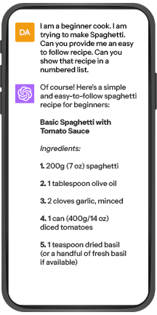
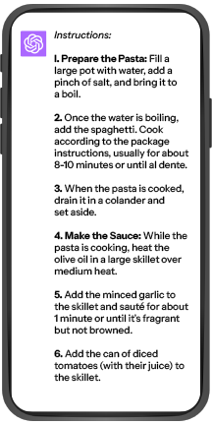
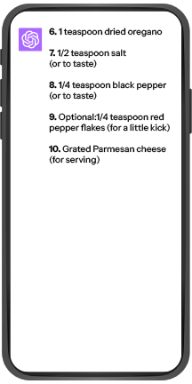
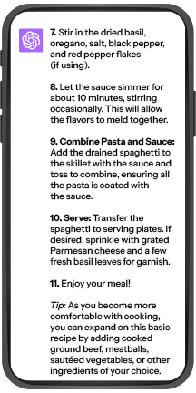
SPAGHETTI JUNCTION
Notes:
EXAMPLE: I picked a very simple example so you can understand the power of this prompt formula
CONTEXT: I am a beginner cook
SPECIFIC INFORMATION: I am trying to make Spaghetti
INTENT: Can you provide me an easy-to-follow recipe
FORMAT OF OUTPUT: Numbered list

Slide 25
VISLA – VIDEO PRODUCTION WITH AI
USE ChatGPT AS A SOUP STARTER
SET BASIC PARAMETERS FOR VIDEO OUTPUT
3) ALLOW VISLA TO CRUNCH & EDIT YOUR VIDEO
Notes:
Now that we made spaghetti, I’m going to show you another tool called VISLA
Visla can take ChatGPT content and generate some great videos for use in:
Social media
Website
Even broadcast television
[cue Visla video]

Slide 26
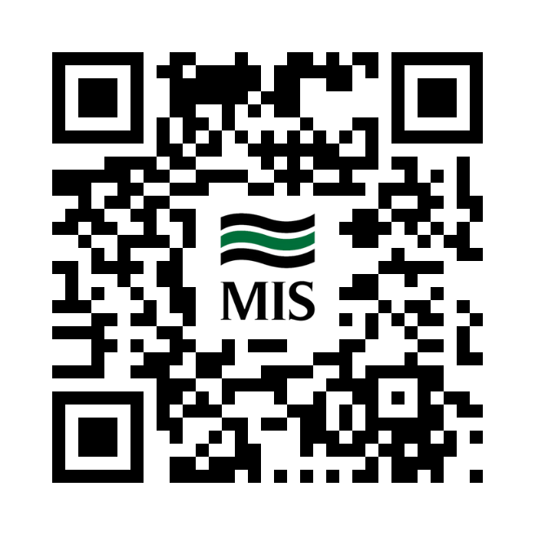
ChatGPT RESOURCES
Notes:
I’m going to show you a few example resources you can consider for your business today
Scan the QR code to be directed to a landing page with downloads & other resources from today’s presentation

Slide 27
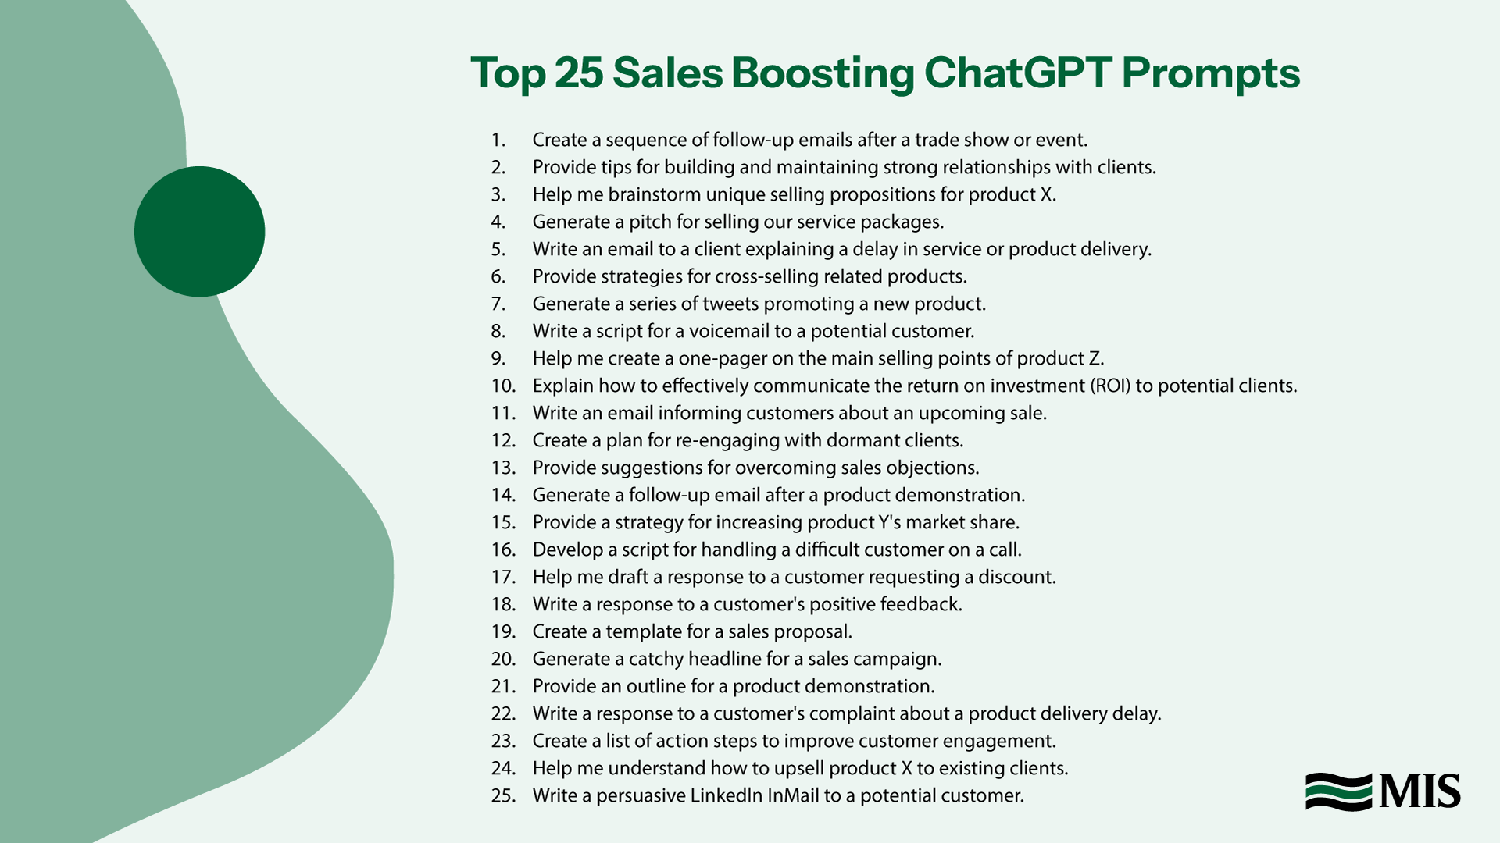
I
Notes:
25 examples of prompt “starters” to help you get the most out of ChatGPT

Slide 28
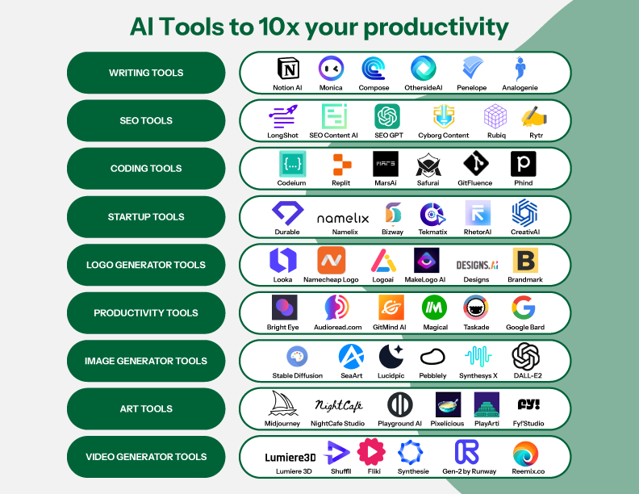
I
Notes:
As mentioned previously – there are 7,000 new apps this year alone.
Here is a sampling of AI enabled applications by category.
This could be used as a starting point when considering where to start.

Slide 29
DATA PRIVACY POLICY
Notes:
WARNING – IF YOU ONLY HEAR ONE THING FROM THIS PRESENTATION TODAY…
IF YOU DON’T HAVE YOUR HOUSE IN ORDER:
Your business is at risk…
You are behind…
You need to SECURE YOUR HOUSE before starting on AI…
To help you get your house in order – here is a sample Acceptable Use Policy for tools like ChatGPT

Slide 30
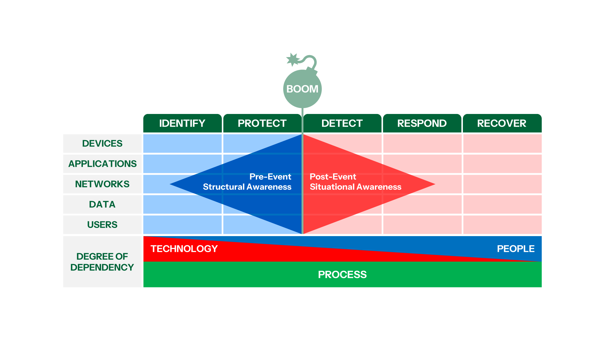
FLASHBACK: LEFT AND RIGHT OF
Notes:
Last year we talked EXTENSIVELY about security – Remember “It’s not IF but WHEN?”
We talked about the concept of “Left of boom” and “Right of boom”
We held a panel discussion with two insurance companies and a breach coach to gain their perspectives on what they are seeing.
We gave you access to A Cybersecurity Roadmap
We talked about the essential plans that you need to have in place to protect your business:
Risk Assessment
Incident Response Plan
Backup / Disaster / Recovery Plan
Change Management Plan
If you need a refresher – We added last years Tech Exchange and resources to this year’s content that you can access using the QR code on the back of your badge.

Slide 31
The DOs and DON’Ts of Artificial Intelligence
Notes:
Like anything new – there are DOs and DONTs.
We have put together a list of these from our own experience.

Slide 32
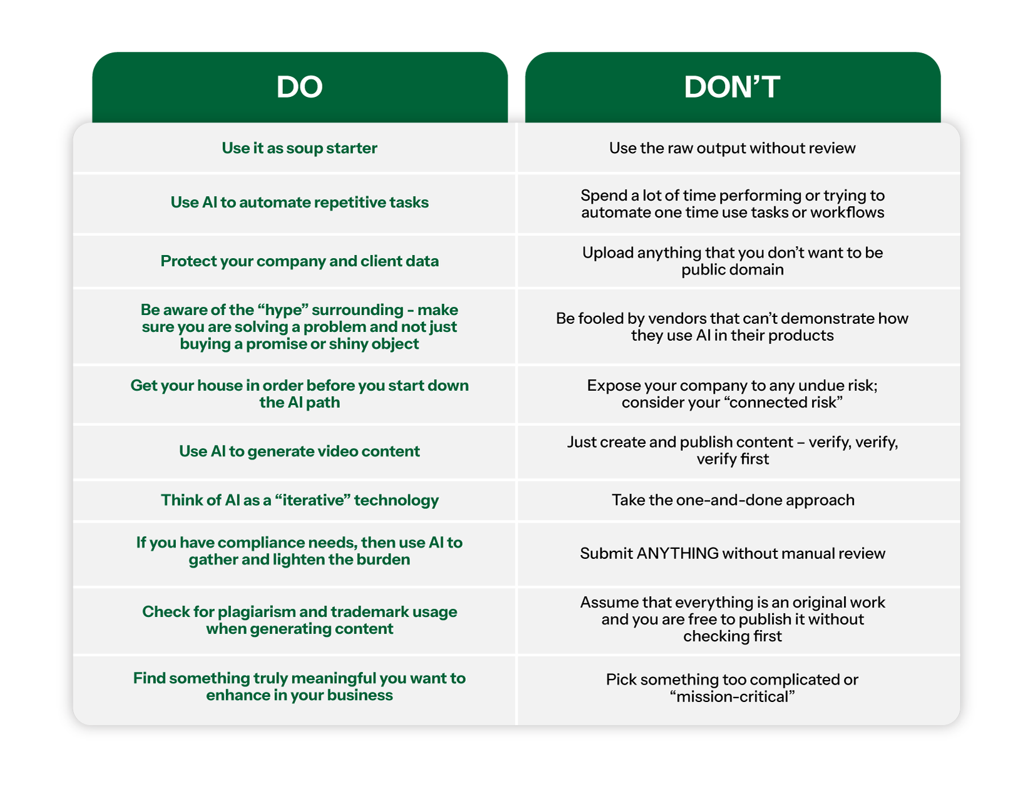
Notes:
DO
Use automation for repetitive tasks
Start with – EASY but MEANINGFUL
Protect your company and client date
DON’T
Don’t automate one-time or rarely used things
Don’t pick something TOO COMPLICATED
Don’t upload anything that is not considered PUBLIC
With that, I want to welcome Jennifer back to the stage.

Slide 33
Q&A with Lliam Holmes
Notes:
Thank you, Lliam – as always, we appreciate your wisdom and guidance as we embark on this moment in history.
We had question cards on your tables during lunch, and I hope you all were able to take a moment and fill out any question you may have had for Lliam. If not, I’m going to give you a few minutes to do so now.
[Dan and Carol collect question cards and provide to Jennifer]
Why did many tech leaders like Steve Wozniak and other tech leaders sign an open letter urging them to tap the brakes on developing advanced AI systems?
2. Is AI going to take my job?
3. AI is overwhelming. How can I practically apply it in my business?
4. Is it safe the use the AI empowered / enabled plugins for M365 and other applications?
Remind crowd that we will answer ALL questions submitted, either at the Road Show or via your CAMs team member.

Slide 34
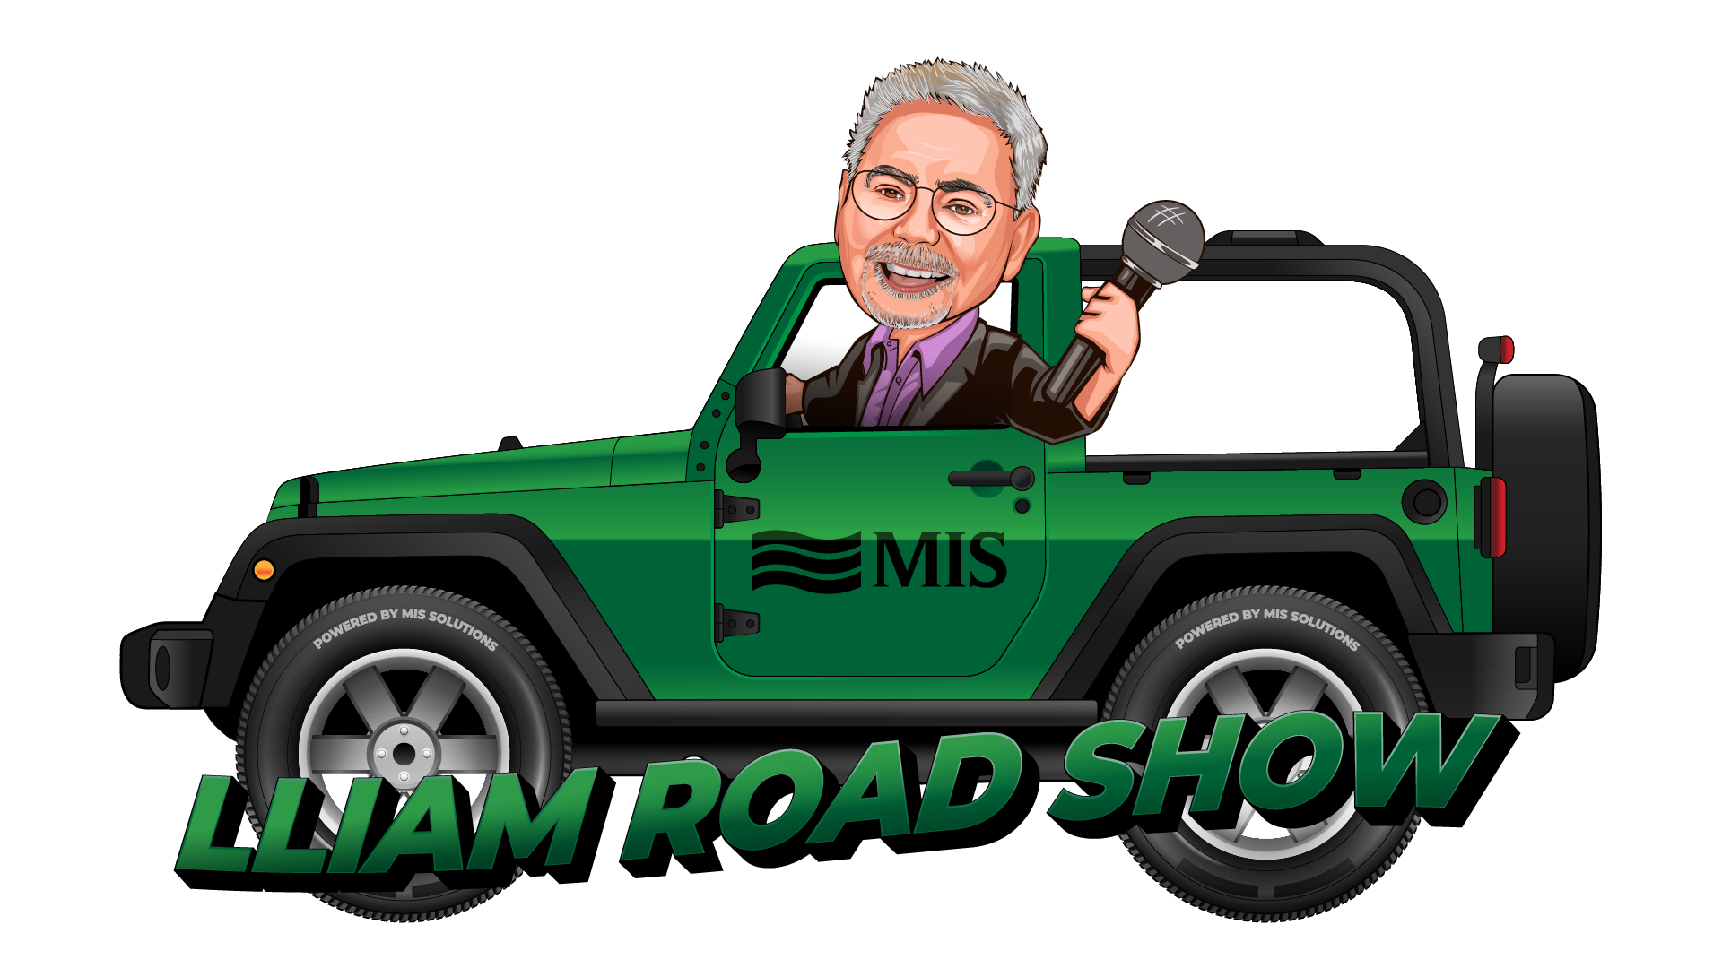
Lliam Road Show - October 2023
Wednesday, October 25, 2023 – Stillfire Brewing Patio – Suwanee, GA 6 pm to 8 pm – RSVP at mis-solutions.com/roadshow
Pose your AI and technology questions to Lliam in a casual setting
Notes:
AI is a big subject and to keep the spirit of TE going year round – we are hosting some causal events at local restaurants and event spaces each month.
Its your chance to chat face to face with Lliam – learn more about emerging AI world and tools.
Next month –we are doing a “deep dive” into the “brain” or neural network behind these amazing AI tools we’ve been demonstrating here today
Join us on Oct 25th 6-8pm at Stillfire Brewery in Suwanee.
Feel free to invite a colleague or someone that you think would enjoy or add to the conversations.
Its our way to continue with the awareness and all part of the conversation….
Good leaders bring everyone across the finish line - so invite a friend or client or vendor….to join us.

Slide 35
REFERRAL ALL STARS
MIS-SOLUTIONS.COM/REFER
Notes:
I’d like to recognize a couple of folks who we consider referral all-stars.
Chris Foster – Whitehead Electric
Chase Burnette – Burnette Insurance
Jon Powell – Moore Colson CPAs
Clay Snellings and several others at Snellings Walters Insurance
Remember, if you feel like sharing your experience with MIS Solutions with another company such as yours, you may refer a business any time by visiting mis-solutions.com/refer.

Slide 36
PREMIER VENDORS & SPONSORS
Notes:
Thank our “friends” of MIS, who made this program possible.
Please join to show appreciation for these companies.
Mission – educate and empower leaders with programming like this and it’s a big lift so we really appreciate our vendors supporting our journey. Please join me in showing appreciation.

Slide 37
No “LIP” Service:
Three Final Takeaways
Learn Your Craft
Integrate Your Craft
Protect Your Property
Notes:
Just to recap, here is a final takeaway about the emerging world of Artificial Intelligence to remember as you leave today.
Learn Your Craft
Integrate Your Craft
Protect Your Property

Slide 38
Thank You!
Notes:
Before we adjourn, don’t forget to scan the above code for resources and a copy of today’s presentation.
We would really appreciate you filling out one more quick card at your table…it’s three quick questions on a scale of 1-10:
What was your overall satisfaction of this event?
How useful was the content?
How likely would you recommend Tech Exchange or Lliam Road Show to a friend or colleague?
We really appreciate you all coming out; we look forward to seeing you on October 25, and we hope this was valuable to you as we enter this bold new era of the Information Revolution!
If you have questions, don’t stress, call MIS. Thank you!

